Slide 1


An examination into cybercrime in the UK considering legal, ethical and social perceptions
Principles of Digital Forensics and Cyber Law module Unit 6
Notes:
This presentation is for the Principles of Digital Forensics and Cyber Law module Unit 6. Titled: An examination into cybercrime in the UK considering legal, ethical and social perceptions.

Slide 2

Learning Outcomes
Critically appraise the global legal and regulatory environment as it applies to cyberspace, and compliance requirements, including the GDPR and the obligations it imposes.
Critically appraise ethical considerations and the rights that people may or may not have in cyberspace, and understand the debates in this area.
Notes:
This presentation's intended outcomes are critically appraising the global legal and regulatory environment concerning cybercrime considering GDPR, ethics and social perceptions.

Slide 3




Scope of the presentation
Notes:
Therefore to address the outcomes, we will focus our presentation on the following:
The United Kingdom & Northern Ireland. Several considerations were made for this chosen country. Initial indications suggested being chosen SAR Hong Kong, China, as this is my current residence, and it would be helpful to examine current case law; however, on the UNODC database, cybercrimes in this location were not identified. The UK and NI were decided upon as this was my country of origin and potentially my future residence. However, this was not the most significant factor in my decision. After researching the UK cybercrimes within the database, it was interesting that most cases were considered dated. The most recent being in 2018, and the chosen case was in 2016, but matters occurred prior. I felt it would be interesting to examine the investigative methods used and whether public perceptions have changed over time to the present day. The case extends to a global level and affects economies worldwide as whilst film production might be in one country, it can be sold in others. This is useful for understanding the global impact of property rights transnationally.
The cybercrime chosen was 'Computer-related acts for personal or financial gain: Fraud' within an organised criminal group. The case involved an underground community of internet users who produced and distributed illicit pirated copies of recent movies violating property rights. In addition to the reasons already mentioned, this case offers implications on national and international levels, mainly as the crime's intended victims could be in other countries who obtain property rights. We can also examine how personal data and GDPR play a significant role in the apprehension of criminal groups.
This case offers a multi-faceted approach to investigative work where the gathering of evidence was not a seamless process with potentially high crime costs.
Finally, we can examine the public and social response to this crime and consider if perceptions are the same in today's society.

Slide 4
R v Baker [2016] EWCA Crim 1637 (UNODC, 2016) Description and explanation
Illicit pirate movies
FACT
Organised criminal group
Peer-to-peer networking
Notes:
This case was brought against an organised criminal group that produced and distributed illegal pirate copies of new and upcoming movies that violated property rights. The criminals were identified by the Federation Against Copyright Theft (FACT) from 2010 to 2015 (UNODC, 2016). The estimated financial loss to property rights holders was 1 million GBP. The group was operated under several names and merged with associated groups specialising in digital editing. Sufficient expertise was needed to facilitate the upload process to large capacity servers, encoding compatible formats for viewing, compressing image quality and removing watermarks originally made by cinemas detailing the time and dates of projection. This required strong group coordination of organisation in labour-intensive activities.
Distributing illegal material was conducted via peer-to-peer networking, whereby movies were hosted on torrent sites that end-users could download. The movies would be split into thousands of parts and reconstructed, increasing transmission speed and efficiently sending files to many computers from a single computer.

Slide 5
Analysis: UK & NI approach to mitigation
Digital Economy Act 2010 and 2017 (UK Public General Acts, 2017)
Voluntary Copyright Alert Programme (Vcap) (Schiff, 2014)
Collaboration with British Phonographic Industry (BPI), Motion Picture Association (MPA) and FACT Administration LLP. (BBC, 2014)
Amendment of Copyright, Designs and Patent Act (Maxwell, 2022)
Creative Content UK initiative Get It Right from a Genuine Site (Creative Content UK Partnership Limited, 2020)
Notes:
The country's approach has developed over time, especially with the change in technological mediums. Today, the use of P2P networking has become redundant partly due to the UK government's initiatives and technology change. Digital piracy has taken forms whereby end-users stream illegal material online rather than download, which has seen the rise in film industry producers providing online legal platforms to stream material, such as Netflix.
The UK's approach initiated the Digital Economy Act in 2010 and later revised it in 2017, aiming at technical measures against persistent pirates. The Voluntary Copyright Alert Programme (Vcap) was created to issue warnings via post/email to users from tracking their IP addresses in collaboration with the UK's largest Internet Service Providers (ISPs). Further sanctions, such as suspension of the internet, could be introduced if offenders did not notice this educational approach.
The Digital Economy Act did, however, amend the Copyright, Designs and Patent Act of 1988, raising the severity of criminal acts that potentially infringe, leading to ten years in prison. Collaboration was extended further with (BPI, MPA and FACT) to support the creative industries and contribute approximately 71 billion GBP to the economy. The creative industries did not advocate this as these end users were not considered the most significant criminals but the underground network of gangs producing and distributing pirate material. This gave rise to 'copyright trolls' whereby companies emerge to collect IP addresses and will send threatening letters claiming legal action if they do not pay the penalty. As this is a criminal matter, whether the end-user paid the penalty would not stop them from being prosecuted. FACT Administration LLP is one organisation that conducts this enforcement and comprises former law enforcement officials.
Further education initiatives were set up with 'Get it right from a genuine site' so users could self-manage their internet learning behaviours and realise the importance of not engaging in illegal material.
Due to these measures, in our case (R v Baker), we see how FACT identified the criminals involved and brought them to court for prosecution.

Slide 6
Analysis: Legislation
Level 1 National
Digital Economy Act (DEA) 2010 and 2017
Copyright, Designs and Patents Act 1988 (UK Government, 2021)
Level 2 International
Section 17 of Digital Economy Act
Anti-Counterfeiting Trade Agreement (ACTA)
Ant-Counterfeiting Group (ACG)
Intellectual Property Office (IP Crime Group, 2021).
GDPR (Intersoft Consulting, N.D. )
Notes:
On a national level, the Digital Economy Act was introduced to protect all users and support copyright holders; however, as Maxwell (2022) mentioned, the implications for all users gained severe criminal consequences. The Act introduced a three-tiered system of Notification, Technical Measures and Blocking Injunctions on any infringements which could impinge the Data Protection Act of the users considering their civil liberties. The household members of the IP address involved may have innocent victims. We should also consider the legal perspective whereby ISPs favour the flow of data and how GDPR protects the end-users data. In obtaining evidence, GDPR should be followed so that privacy violations do not occur and cause any issues to the chain of custody.
In the case example, arrests were made in the homes of Rafiq and Baker, where analysis of equipment revealed evidence of software to edit video, encode torrents and overcome copyright protection condemning the group members to Category 1 and 1A offences between sentences of two to four years and half years for five members.
On an international level, Section 17 of the Digital Economy Act allows website blocking injunctions (Mene, 2010). This could have been incorporated in the R v Baker case, as the group was in the process of uploading material to a Chinese website during the arrest. Therefore lobbying from governments is vital for compliance with international ISPs. The Anti-Counterfeiting Trade Agreement (ACTA) was aimed at bringing countries together; however, the UK and EU nations dropped this due to the invasion of privacy by the agreement, which reduces global combat on digital piracy.
The Intellectual Property Office leads the Anti-Counterfeiting Group, which engages with agencies such as Europol, Interpol and WCO to coordinate intelligence to gather evidence to tackle Intellectual Property crime in the UK and other countries.

Slide 7
Analysis: Tools
Tool | Strengths | Limitations
Web monitoring | FACT successfully identified the criminals through Vcap. Strategic stages of intervention Supports behaviour change of end users to adopt legal means such as streaming e.g. Netflix (Petersson & Breul, 2017) | Overall limited conclusive evidence of success longer term and Vcap is under-researched (Leeuw, 2017) Vcap aims to deter however Reece Baker reoffended after released on bail. (UNODC, 2016)
Disk Forensics | Extracts evidence from storage and deleted files from computers or mobile devices. | The growth in Solid State Drive (SSD) technologies will make it more difficult for forensic teams to retrieve deleted artifacts of evidence (Kumar, 2021)
Network Forensics | Supporting monitoring and analysing traffic for legal evidence and information. | Judges can decide evidence to be insufficient for a warrant due to privacy laws. (Alqahtany et al., 2015) Technology advances can support criminals with high speed scalability and anti-forensics
Confiscation and seizure of property and equipment (Hardware and software) | Searches and arrests made with confiscation of equipment through web monitoring (UNODC, 2016) | Seizure of assets may not be a complete deterrent and criminals will use others means such as Virtual Private Networks (VPN) for anonymity or base in other countries (Walter, 2019)
Collaboration with private agencies | Movie studios supported FACT by gathering evidence for law enforcement agencies | Limited government funding and timescale of Vcap initiative meant reliance on the private sector
Notes:
The tools used in this apprehension of the criminal group mainly focused on web monitoring through the Vcap initiative. FACT successfully monitored the group activities over time, following the strategy imposed by Vcap and collaborating with private sector movie studios to pass crucial evidence to the law enforcement agency. This was important to send our clear messages to future organised criminals and end users to change their behaviour. As supported by Petersson & Breul (2017), there was a future reduction in illegal file-sharing or streaming, and users adopted more legal mediums such as Netflix.
Social media monitoring played a role as the defendants made a mistake by accidentally divulging personal details on social media sites such as Instagram and the customer support section of an online retailer, which meant he could be tracked via his Facebook profile (Cooper, 2015).
However, Leeuw (2017) argues that success is short-lived as the limited research in Vcap meant that criminals would use advertisements on their sites to generate profits and use online streaming instead of peer-to-peer file sharing. Vcap's deterrence is also questioned as, in this case, one of the defendants Reece Baker once released on bail, purchased new equipment and reoffended in the same manner as before his arrest (UNODC, 2016). Further limitations could be considered as the UK government has limited time and funding for the Vcap initiative, which meant the copyright holders in the private sector would need to fund and support FACT in bringing criminals to justice.
Property and equipment were seized during the investigation through extensive web monitoring; however, Walter (2019) suggests this may not be a helpful deterrent as criminals can try to mask online identity through Virtual Private Networks (VPN) or base their sites in other countries, which limits direct intervention.

Slide 8






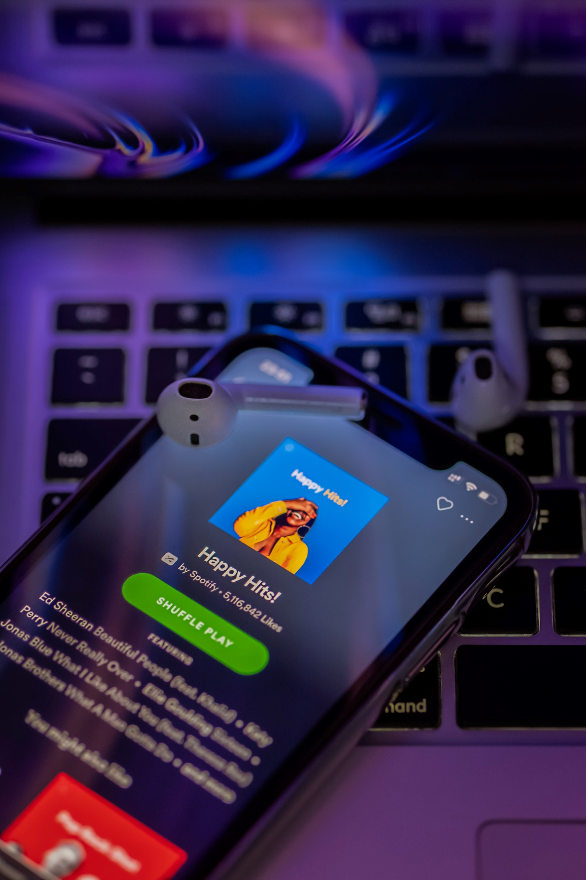


Analysis: Cost identification
(Torrent Freak, 2015)
(Smolaks, 2019)
(Heeks et al., 2018)
(Karwowska, 2015)
(Oberholzer-Gee & Strumpf, 2016)
Notes:
According to FACT, the victim copyright holders, the majority based in the United States, occurred a revenue loss of approximately 52 million GBP (Torrent Freak, 2015), with the criminal group admitting in court causing more than 5 million GBP. However, the economic costs delve far further with this case just a small part of the overall picture where Fraud and Cybercrime accounted for costs above 5.8billion GBP in England and Wales in 2015/16 (Heeks et al., 2018).
The process of web monitoring was a lengthy and coordinated procedure by FACT and involved participating Internet Service Providers in the Vcap initiative partly funded by the UK government. Whilst costs for the cases are unknown, the actual total costs of the Vcap initiative, which targeted educating end users, were cancelled in 2019, with associated agencies unwilling to share the financial costs involved (Smolaks, 2019).
Organisations such as FACT employ specialist staff with experience in law enforcement and have links to national and international agencies, which identifies the extensive network of the financial cost.
The economic and social costs of fraud and cybercrime also should consider the emotional harm, such as fear 9%, depression 3% and anxiety 7% of total crimes. More physical and mental costs can affect innocent people who fear the cost of a crime they may never commit. Furthermore, the carbon cost of crimes such as this has environmental impacts such as caring for victims, policing and managing the criminals, and transportation and administration. (Heeks et al., 2018). The carbon footprint per case, such as this fraud and cybercrime case, could be estimated at 0.5, a high cost.
Creative industries have blamed digital piracy and file sharing for the decline in sales of physical CDs and DVDs (Karwowska, 2015); however, it is argued that in the case of music, this has no noticeable effect. It results opposite, as users can sample music before purchasing (Oberholzer-Gee & Strumpf, 2016). With the rise of free online applications such as Spotify and paid applications like Netflix, the full economic potential of file sharing may not have been fully considered, as end users prefer simplicity and ease of use.

Slide 9


Analysis: Gathering of evidence
Identification
Preservation
Analysis
Reporting
Collection
Acquisition
Notes:
The digital forensic evidence-gathering lifecycle takes upon the numerous phases of identification, collection, acquisition, preservation, analysis and reporting (Nalawade et al., 2016). This protocol for best practice adheres to the regulatory guidelines of ISO/IEC 27037:2012 that identifies, collect and preserves digital evidence and the Association of Chief Police Officers (ACPO) procedure for managing digital evidence (Yapp, 2021). Law enforcement authorities seized numerous equipment upon arrests, such as computers, USB devices, mobile phones and camcorders. The defendant Baker erased his computer hard drive before the search, and the software installed could encrypt and securely delete activity history. Many digital tools, such as digital forensics, would be needed to recover deleted material and uncover critical evidence. Forensic imaging software such as FTK Forensic Toolkit is helpful for this. Network forensic analysis played a crucial part in monitoring and apprehending the criminals, which was an effective tool in gaining evidence over the three-year investigation. Software such as Encase can also support this investigation; however, FACT has its in-house forensics team (FACT, 2022).
The benefits of gathering this evidence meant that evidence was not damaged or compromised. It was extracted and adequately handled with a continuing chain of custody established and maintained.
However, there are challenges: Technically organised criminals have new emerging technology, such as Internet of Things devices and can encrypt data which delays investigation time. Cloud storage and steganography can make the investigation more complex (Joshi, 2022). A critical factor in the apprehension of the criminals was due to a social media trail of data giving away their identities which did not use highly sophisticated software (Cooper, 2015).
The inconsistent global legislation makes it difficult to intervene transnationally, offering legal barriers directly. Also, more commonly, there are issues of privacy and admissibility in court of the evidence collected. Further challenges are identified by Horsman (2020) that ACPO governing principles (Yapp, 2021) are outdated for contemporary forensic analysis, and this could limit the quality assurance of future evidence collection.

Slide 10
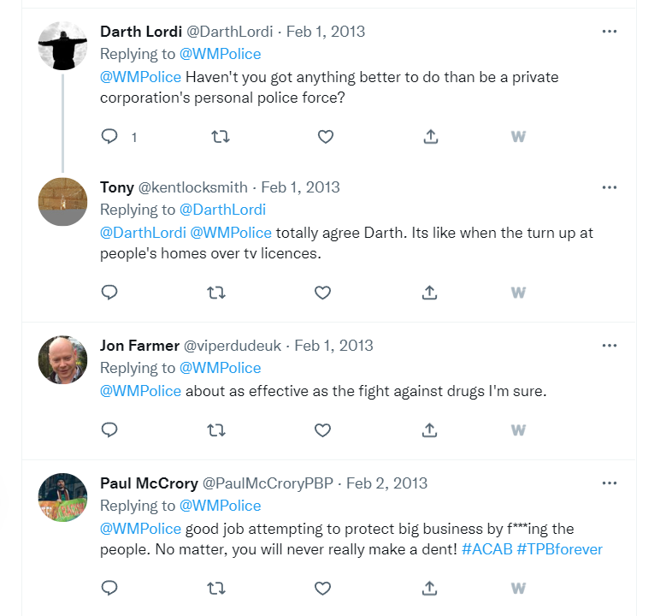
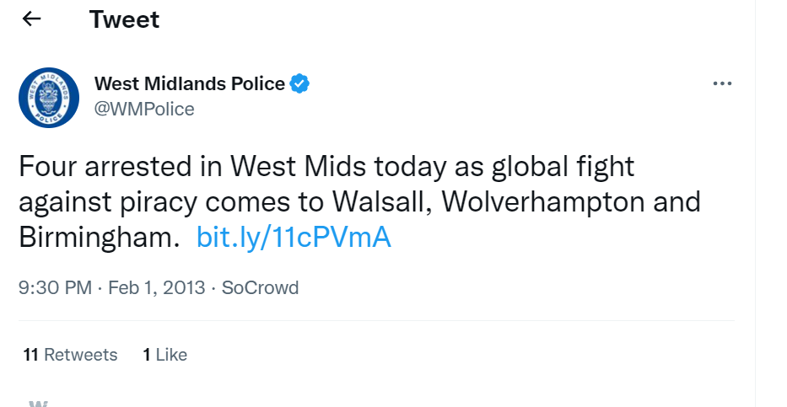
Social perception
(West Midlands Police, 2013)
Notes:
The social perception contrasts depending on the nature of the topic. On Twitter (West Midlands Police, 2013), the public response to the defendants' arrests is hostile towards law enforcement, suggesting they are not performing public duty and supporting private corporations. They also suggest that this crime is not that significant, suggesting that the battle to stop digital piracy is never-ending.

Slide 11
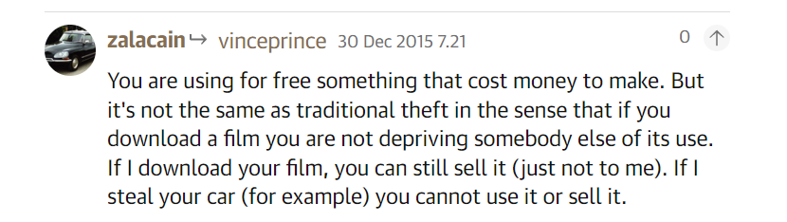
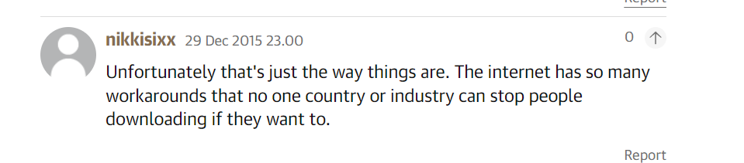
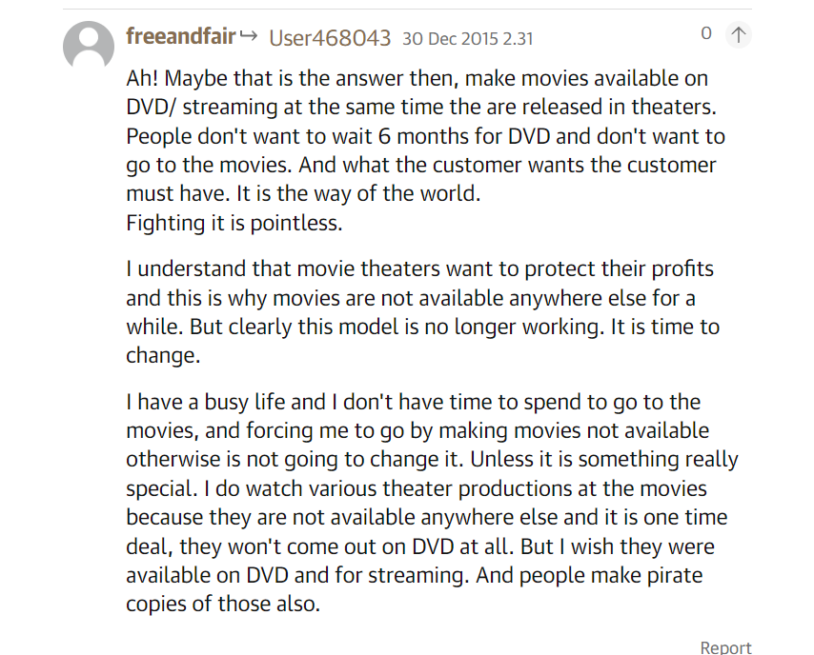
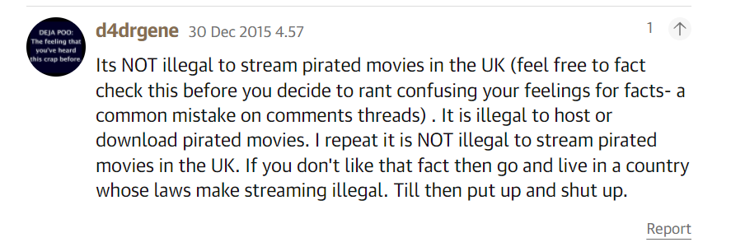
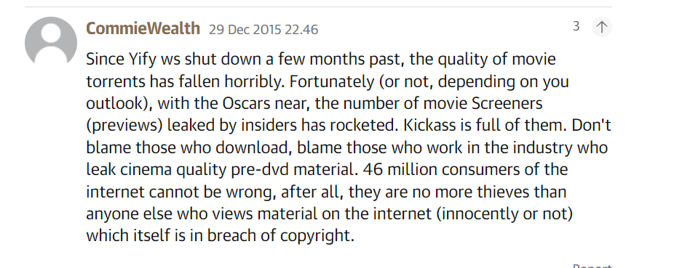
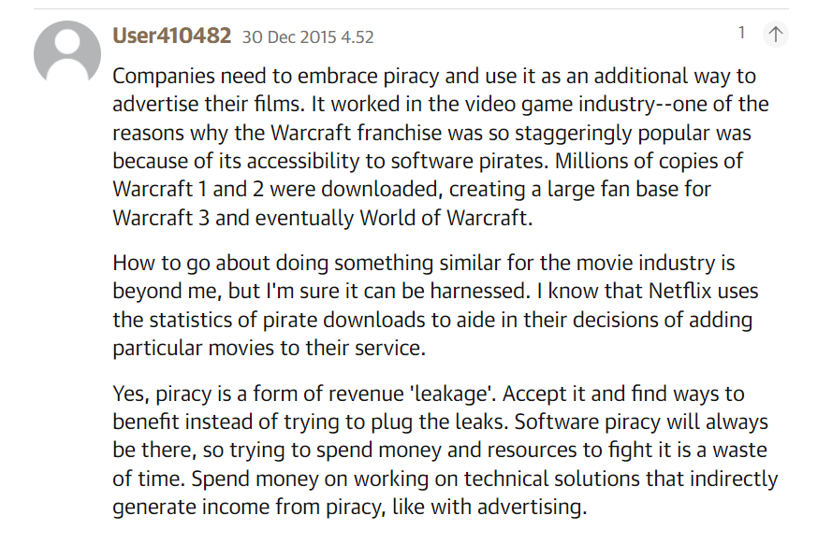
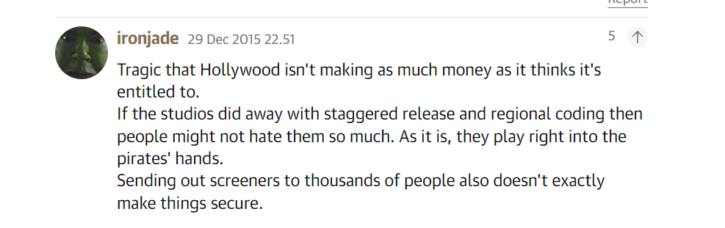
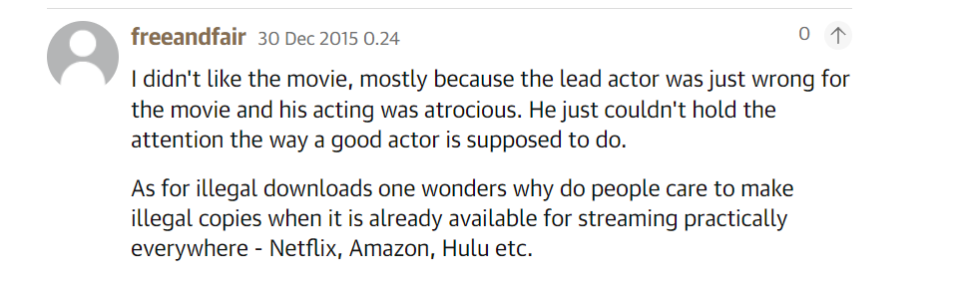
Social perception
(Child, 2015)
Notes:
However, the nature of this case dissolves from the perpetrators' actions but towards the debate of whether people are acting ethically correctly.
Firstly, the social view is that copyright holders are blamed for facilitating digital piracy by releasing sample movies before release dates, and the insider threat should be targeted.
The KMPG report commissioned by NBC Universal suggests that only 16 % of the latest and most popular movies are on legal streaming sites like Netflix (Van der Sar, 2014). Views follow this by suggesting pirates are being bred because users want to view the latest releases, and studios hold these back due to regional rights issues. However, many enjoy the convenience and quality streaming that online piracy cannot offer.
Finally, there is a debate over downloading and streaming and whether they can be considered theft. An interesting perspective is that piracy is a form of revenue and suggestions that piracy will never diminish, so generating revenue from it would be more suitable. Whilst these views are contemporary of the time, they are dated compared to today's society. With the expansion of legal streaming sites offering high-quality, new material movies, it seems people prefer following ethical practices and many popular movie platforms.

Slide 12
References
Alqahtany, S., Clarke, N., Furnell, S. & Reich, C. Cloud forensics: a review of challenges, solutions and open problems. 2015 international conference on cloud computing (ICCC), 2015. IEEE, 1-9.
BBC. (2014). Deal to combat piracy in UK with 'alerts' is imminent. Available from: https://www.bbc.com/news/technology-27330150 [Accessed 26 October 2022].
Child, B. (2015). Interstellar most pirated movie of 2015 with 46m illegal downloads. Available from: https://www.theguardian.com/film/2015/dec/29/interstellar-most- pirated-movie-2015-46m-illegal-downloads [Accessed 2015 2022].
Creative Content UK Partnership Limited. (2020). Get it right from a genuine site. Available from: https://www.getitrightfromagenuinesite.org/ [Accessed 26 October 2022].
Fact. (2022). Computer Forensics. Available from: https://www.fact-uk.org.uk/services/computer-forensics/ [Accessed 28 October 2022].
Heeks, M., Reed, S., Tafsiri, M. & Prince, S. (2018). The economic and social costs of crime. In: HOME OFFICE (ed.) Research Report 99. London: Crown.
Horsman, G. (2020). ACPO principles for digital evidence: Time for an update? Forensic Science International: Reports, 2, 100076.
Intersoft Consulting. (N.D. ). GDPR. Available from: https://gdpr-info.eu/ [Accessed 22 January 2022].
Ip Crime Group. (2021). IP CRIME AND ENFORCEMENT REPORT 2020-21. Available from: https://assets.publishing.service.gov.uk/government/uploads/system/uploads/attachment_data/file/1017790/ip-crime-2021.pdf [Accessed 26 October 2022].
Joshi, S. (2022). Digital Forensics. Available from: https://www.g2.com/articles/digital-forensics [Accessed 28 October 2022].
Karwowska, A. (2015). Copyright and the Digital Economy Act: A Comparative Perspective. European Journal of Comparative Law and Governance, 2, (1): 19-36.
Notes:
Slides 12 and 13 are the References.

Slide 13
References
Leeuw, H. 2017. Using Big Data to Study Digital Piracy and the Copyright Alert System 1. Cyber Society, Big Data, and Evaluation. Routledge.
Maxwell, A. (2022). Piracy, It’s a Crime: UK Govt. Ignored Warnings, Now Families Pay The Price. Available from: https://torrentfreak.com/piracy-its-a-crime-uk-govt-ignored-warnings-now-families-pay-the-price-220601/ [Accessed 26 October 2022].
Mene, A. (2010). Piracy and illegal file-sharing: UK and US legal and commercial responses. Available from: https://uk.practicallaw.thomsonreuters.com/1-502-7956?transitionType=Default&contextData=(sc.Default)&firstPage=true#co_anchor_a768346 [Accessed 26 October 2022].
Nalawade, A., Khangar, S. & Mane, V. (2016). Forensic analysis and evidence collection for web browser activity.
Petersson, G. J. & Breul, J. D. (2017). Cyber society, big data, and evaluation. New Brunswick, Transaction Publishers.
Schiff, B. (2014). Copyright Alert System: Six-Strikes and Forced Arbitration Might Not Be the Answer. Cardozo J. Conflict Resol., 16, 909.
Smolaks, M. (2019). British ISPs throw in the towel, give up sending out toothless copyright infringement warnings. Available from: https://www.theregister.com/2019/07/20/creative_content_piracy/ [Accessed 28 October 2022].
Torrent Freak. 2015. UK Movie Pirates Sentenced to a Total of 17 Years. Available from: https://ecirtam.net/autoblogs/autoblogs/torrentfreakcom_00f36bf7c74f1bd5df981a2750b4447ba96f5517/?786 [Accessed 28 October 2022].
UK Government. (1988). Copyright, Designs and Patents Act. In: INTELLECTUAL PROPERTY OFFICE (ed.).
UK Public General Acts. (2017). Digital Economy Act 2017. United Kingdom: TSO (The Stationery Office).
UNODC. (2016). R v Baker [2016] EWCA Crim 1637. Available from: https://sherloc.unodc.org/cld//case-law-doc/cybercrimecrimetype/gbr/2016/r_v_baker_2016_ewca_crim_1637.html?lng=en&tmpl=sherloc [Accessed 09 October 2022]
Van Der Sar, E. (2014). Most Top Films Are Not Available on Netflix, Research Finds. Available from: https://torrentfreak.com/most-top-films-are-not-available-on-netflix-research-finds-140926/ [Accessed 28 October 2022].
Walter, J. M. (2019). Regulating mediators of internet piracy: P2p websites and cyberlockers. Digital Policy, Regulation and Governance.
West Midlands Police. (2013). Four arrested in West Mids today as global fight against piracy comes to Walsall, Wolverhampton and Birmingham. . In: @WMPOLICE (ed.). Twitter.
Yapp, P. (2021). Computer forensics and the ACPO guide. Available from: https://www.scl.org/articles/12161-computer-forensics-and-the-acpo-guide [Accessed 28 October 2022].

Slide 14
Credits
Images
Men And Women With Drinks Watching 3d Film by Jacob Lund Photography from NounProject.com
Person Using Laptop Keyboard by Scopio from NounProject.com
Photo by Peter Stumpf on Unsplash
Photo by AJ Colores on Unsplash
Photo by Omid Armin on Unsplash
Photo by Thibault Penin on Unsplash
Photo by De'Andre Bush on Unsplash
Notes:
Slide 14 is the Image Credits list.
Thank you for listening, and I hope you enjoyed the presentation.

